Slide 1
AUTOMATIC WATER DISPENSER
MICROPROCESSORS
GROUP 21

Slide 2
Group Members
1856022
1856122
1856222
1856322
1856422
1856522
1856622
1856722
1856822
1856922
Marfo Derrick Boateng
Mensah Clinton Joseph
Mensah Jackson Danquah
Mensah Abobi Macrina Elikem Abla
Monney Daniel
Monney Josiah Andah
Nabenjon Kwame Gideon
Nkrumah Christian Asante
Ntiamoah-Sarpong Akua Boatemaa
Ntsin-Essel Kingsford

Slide 3
Presentation Outline
1. Problem Statement
2. Components
3. Schematic Diagram
4. Circuitry
5. Methodology
6. Working Principle
7. Simulation
8. Conclusion
-Challenges faced
-Future Enhancements
-Real-World Applications

Slide 4
Problem Statement
Manual water dispensers often require physical contact, increasing the risk of contamination and spreading germs.
Improper handling of water dispensers frequently leads to unnecessary wastage of water, compromising sustainability.
To address these challenges, the objective is to design an automatic water dispenser equipped with sensors, ensuring both hygiene and efficient water usage.

Slide 5
Components
Hardware Components:
-Ultrasonic sensor
-Breadboard
-Arduino Uno
-Capacitor
-Battery
-Hobby gearmotor
-Relay

Slide 6
Methodology
The project was carried out by first identifying the need for an automated water dispenser and selecting the required components. The circuit was designed and simulated using Tinkercad, with an ultrasonic sensor used to detect hand presence and control the motor. The Arduino code was developed to manage the system’s operation, followed by testing and calibration to ensure accuracy and efficiency. To control switching on and off the piezo and the gearmotor, a relay was introduced into the system.

Slide 7
Working Principle
Hand Gesture Detection- The ultrasonic sensor detects hand gestures, such as placing a hand under the spout or making a specific motion. The sensor emits high-frequency ultrasonic waves and measures the time it takes for the waves to bounce back.- When a hand is detected, the sensor sends a signal to the Arduino microcontroller.
Arduino Microcontroller- The Arduino receives the signal from the ultrasonic sensor and interprets it as a command to dispense water. The Arduino is pre-programmed with specific instructions, such as the amount of water to dispense and the duration of the dispensing process.
DC Motor Actuation- The Arduino sends a signal to the DC motor, which actuates the water dispensing mechanism. The DC motor controls the flow of water, ensuring a precise volume is dispensed. Non-Contact Water Dispensing. The water is dispensed through a spout or nozzle, without requiring physical contact. The non-contact operation helps maintain hygiene and reduces the risk of germ transmission.
The combination of ultrasonic sensing, Arduino microcontroller, and DC motor actuation enables a touchless, precise, and efficient water dispensing system.

Slide 8
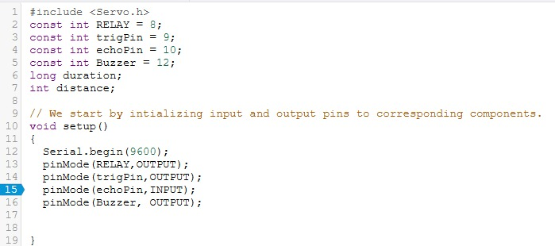
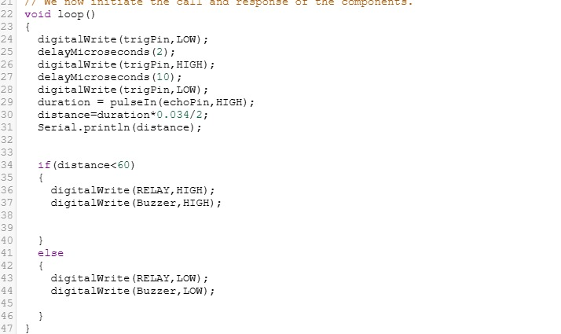
Code used

Slide 9
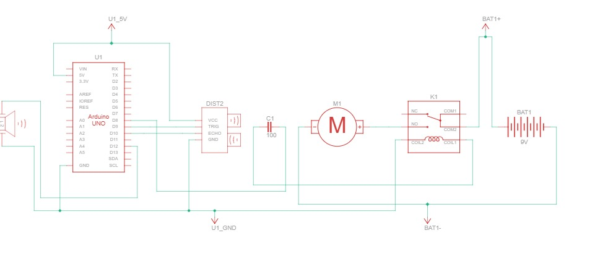
Schematic Diagram

Slide 10
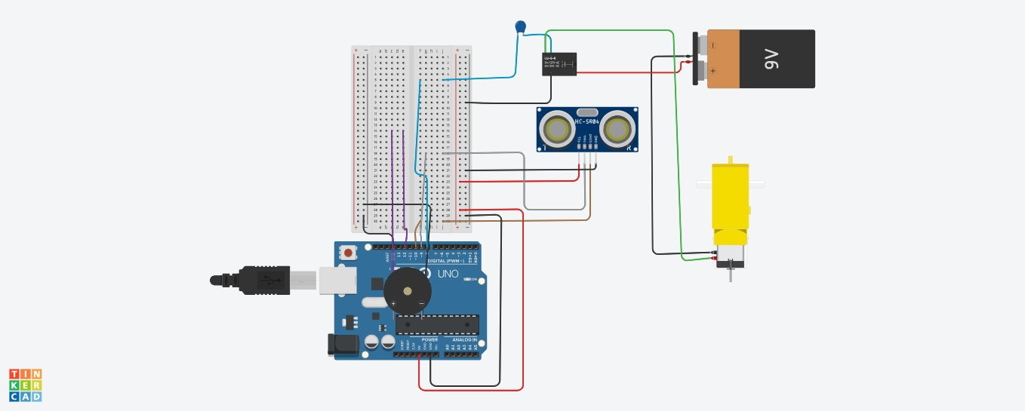
Circuitry

Slide 11
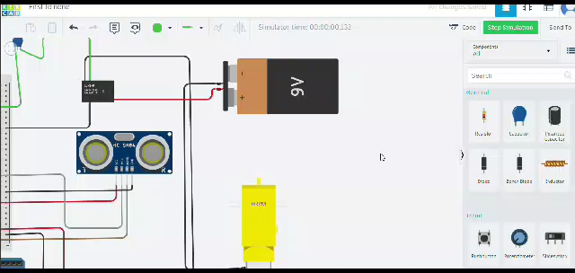
Simulation

Slide 12
Conclusion
To summarize, our Arduino-based automatic water dispenser successfully detects hand movements using an ultrasonic sensor and activates a motor to dispense water. We designed, simulated, and troubleshooted the system in Tinkercad before real-world testing.

Slide 13
Challenges Associated with the Project
During the development of our automatic water dispenser, we encountered several technical challenges:
Powering the Gearmotor: The Arduino Uno, serving as the microcontroller, was unable to directly power the gearmotor due to insufficient power output. To address this, we integrated an external power source—a 9V battery—which ensured smooth operation of the motor and maintained system reliability.
Relay Current Draw: The relay was drawing excessive current from the Arduino Uno, surpassing its 20mA current limit. This not only reduced the microcontroller's performance but also risked shortening its lifespan. Initially, we introduced a resistor into the circuit. While resistances of 75Ω and above allowed the gearmotor to function, the underlying issue persisted. To stabilize the current and protect the system, we supplemented the circuit with a capacitor, which successfully resolved the problem.

Slide 14
Future Enhancement
LCD display: Integrating an LCD display can provide users with valuable information, such as; Water temperature, water quality, maintenance alerts and usage statistics
Wi-Fi connectivity for monitoring: Adding Wi-Fi connectivity can enable remote monitoring and control of the dispenser. This feature can be useful for; Tracking water usage and detecting leaks, receiving maintenance alerts and notifications and adjusting settings and schedules remotely
More efficient motor system: Upgrading the motor system can lead to; reduced energy consumption, increased reliability and lifespan, quieter operation and improved performance and responsiveness

Slide 15
Real-World Applications
Public Restrooms & Kitchens: The touchless operation enhances hygiene by reducing the need for physical contact, effectively minimizing the spread of germs and bacteria. This makes it an ideal choice for maintaining cleanliness in high-traffic areas.
Gardening & Irrigation: The dispenser's proximity-based activation can be adapted to automate plant watering systems, ensuring precise water delivery to plants when needed. This approach conserves water while promoting healthy plant growth.
Hospitals & Laboratories: In environments where sterility is crucial, such as hospitals and labs, the dispenser minimizes the risk of contamination by enabling touch-free access to water.

Slide 16
THANK YOU

